Slide 1
Estate Planning Council of Rochester, NY - January 23rd, 2024:
 | “Preserving Family Values by Encouraging Social & Fiscal Responsibility with Modern Trust Structures”
South Dakota:
New York:
● Pierce H. McDowell III ● Al W. King III
● Matt Tobin ● James Paladino
Nevada Office
SDTC Services of NV
3605 South Town Center Dr Suite A
Las Vegas, NV 89135
Sioux Falls Office South Dakota Trust Company LLC SDTC Services LLC 201 South Phillips Ave, Suite 200 Sioux Falls, SD 57104 Phone (605) 338-9170 Fax (605) 274 -9200 | Rapid City Office South Dakota Trust Company LLC 4020 Jackson Blvd, Suite 3 Rapid City, SD 57702 Phone (605) 721-0630 Fax (605) 721-0634 | Wyoming Office SDTC Services of WY 890 W Broadway Jackson Hole, WY 83001 Phone (307) 739-4372 | New York Office South Dakota Planning Company 10 East 40th Street, Suite 1900 New York, NY 10016 Phone (212) 642-8377 Fax (212) 642-8376 | Westport Office SDTC Planning of CT 274 Riverside Avenue, 2 ^{nd} Floor Westport, CT 06880 Phone (203)635-2262
www.sdtrustco.com / www.privatefamilytrustcompany.com / www.directedtrust.com

Slide 2
“Preserving Family Values by Encouraging Social & Fiscal Responsibility with Modern Trust Structures”
Tax [vs.] non-tax
Great great grandparents
Remember name [vs] values
Concern – protect
Inheritance – process not an event
Values
Wealth
Economic
Future Uncertainties
Political
Lawsuits
Taxes

Slide 3
“The Main Generations in the U.S Today:
The Greatest Generation – born 1901-1927
The Silent Generation – born 1928-1945
The Baby Boom Generation – born 1946-1964
Generation X – born 1965-1980
Millennial Generation – born 1981 - 1996
Generation Z – born 1996 – 2012
Generation Alpha – born 2013 – 2025
Source: Care Givers of America, “2022 Generations Named Explained”

Slide 4
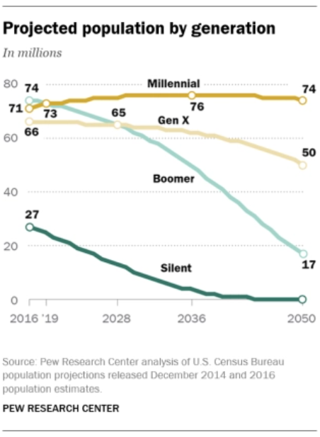
Millennials Currently Outnumber Baby Boomers:
Millennials (numbered 72.1 million) have surpassed Baby Boomers (numbered 71.6 million) as the largest living adult generation*
*Immigration has assisted with boosting the number of Millennials
Source: Pew Research Center, “Millennial Life: How Young Adulthood Today Compares With Prior Generations” May 14th, 2020
Pew Research Center, “Millennials overtake Baby Boomers as America’s Largest Generation” April 28th, 2020
4

Slide 5
Millennials and Housing:
15% of Millennials were still living in their parents’ home
This is nearly double the amount of young Baby Boomers
Approximately 64 million Americans or 20% of the population are living in multigenerational households
Source: Pew Research Center, “Millennial Life: How Young Adulthood Today Compares With Prior Generations” May 14th, 2020
5

Slide 6
“Preserving Family Values by Encouraging Social & Fiscal Responsibility with Modern Trust Structures”
$68 trillion to pass next 20 years
From: Baby Boomers (Born 1946 – 1964)
To: Generation X (Born between 1965 – 1980)
(and)
Millennials (Born between 1981 – 1996)
Millennials: Will go from holding (next 10 – 20 years)
3% of wealth
to
60% of wealth
6

Slide 7
Summary of Inheritance by Asset in U.S.:
Real estate - $38.8 trillion
Equities - $35.7 trillion
Pensions - $30 trillion
Business interests - $17 trillion
7

Slide 8
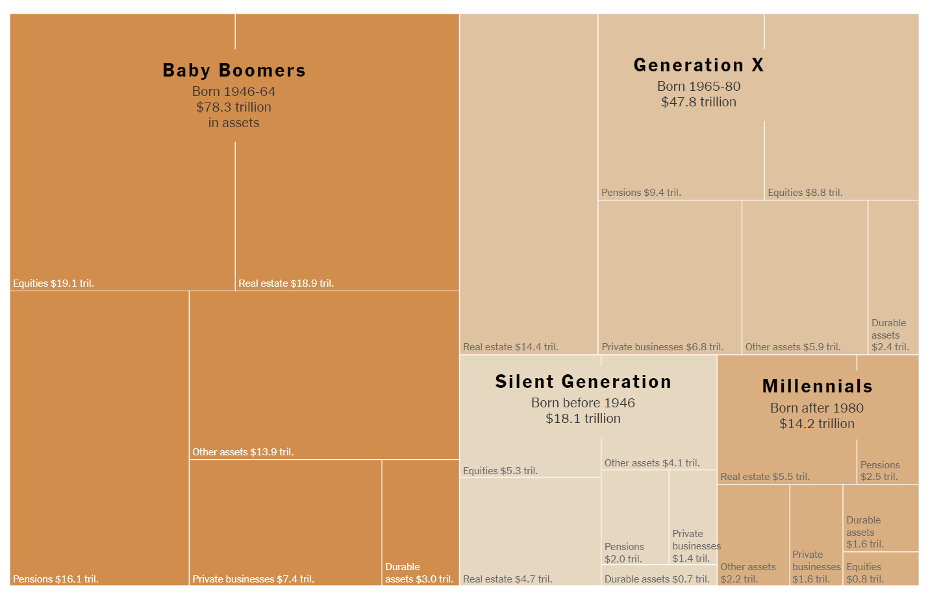
Baby Boomers Hold Half of the Nation’s $140 Trillion in Wealth:
Source: New York Times, “The Greatest Wealth Transfer in History Is Here, With Familiar (Rich) Winners” May 23, 2023

Slide 9
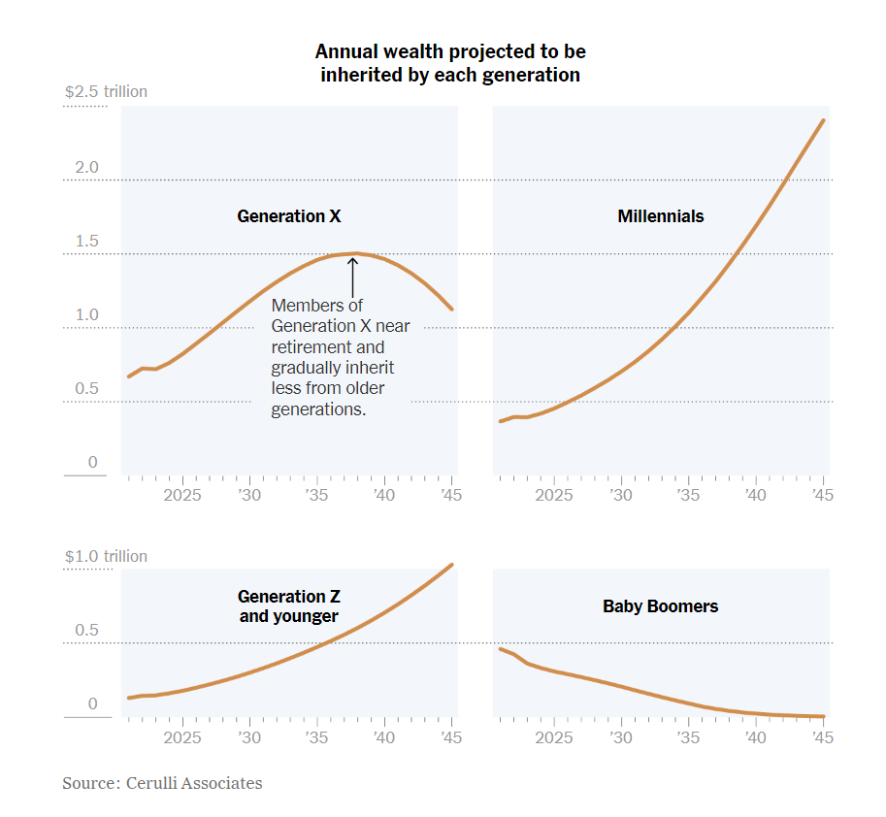
Annual Wealth Projected to be
Inherited by Each Generation:

Slide 10
Inheritance:
15% of U.S. adults expect to receive inheritance
42% confident they can handle new wealth
61% of Baby Boomers parents not confident children are well prepared to handle inheritance
Millennials – 21%
Generation Z – 18%
Source: Fortune – July 21, 2023

Slide 11
Inheritance (cont’d):
33% of wealthy Baby Boomer parents have disclosed their wealth to their children
50% believe children mature enough 25-34 years old
25% believe children mature enough 40 years old
Beneficiary quiet trust (limited by state)
Optional to provide beneficiaries with trust information
Can select which beneficiaries will not receive trust information
If trust distribution made to beneficiary
Not necessary to provide any trust information other than the distribution check
Trust quiet even after grantor’s death or incapacity
Trust Protector can decide
Still able to keep the trust quiet
Not limited to a time period
Source: U.S. Trust study
* Source: Al W. King, III “Should You Keep a Trust Quiet (Silent) From Beneficiaries” Trusts & Estates Magazine, April 2015.
11

Slide 12
“Giving While Living”
Heirs increasingly do not have to wait for passing of elders to benefit from family assets: popularity of “Giving While Living”
Reasons for “Giving While Living”
Baby Boomers benefited: financial [and] housing markets
Average price of U.S. home: 500% increase since 1983
S&P 500 2,800% growth since 1983
$13.6 million estate, gift and generation skipping exemptions
Due to sunset to $5 million (indexed) by 12/31/25
Modern directed trust promoting family values (social & fiscal responsibility)
Result: 12.5% gifts to trust 1995 (currently 40%)

Slide 13
Overview – Flexible Modern Directed Trusts:
Provide powerful opportunity for Family and Family Advisor involvement
Directed Trusts created with “open architecture”
Collaborative relationship among beneficiaries and trustee
Multiple trustees/fiduciaries and managers assume duties once assigned to single trustee:
Specialization of function (distributions, investments, custody, administration)
Active family and family advisor involvement

Slide 14
Flexible Modern
Directed Trust:
Directed Trust (Trifurcated Fiduciary Structure):
Investment Advisor or Committee
Administrative Trustee
Directs trustee regarding investments
Distribution Advisor or Committee
(Administrative trustee) as directed administrative trustee
Directs trustee regarding distributions
*Please note: Combine Investment Advisor and Distribution Advisor → Trust Advisor

Slide 15
Traditional Trust Investing [Versus] Flexible Modern Directed Trust:
Traditional - Prudent Investor Act (PIA) – holds trustees to higher standard
Requires trustees:
to pursue an overall investment strategy
to consider various factors in formulating an investment program, including:
size of portfolio
nature and likely duration of trust
liquidity and distribution requirements
general economic conditions – inflation/deflation
tax consequences of investment/distribution decisions
Expected total return
Role of individual investments in portfolio
Can delegate duty but not risk
Flexible Modern Directed Trust dramatically lowers family and/or individual’s fiduciary liability (which is personal liability)
Gross negligence/willful misconduct standard

Slide 16
Key Investment Management Advantages of the Flexible Modern Directed Trust:
Ability to override Prudent Investor Act (PIA)
Ability to utilize 33% stocks, 33% fixed income/cash and 33% alternative investments
Versus traditional 60% stocks, 40% fixed income & cash
Ability to hold one trust asset – Public/private or cash
No requirement to diversify
Ability to broadly diversify if desired with sophisticated investments
.
Please see: Al W. King, III “Myths About Trusts and Investment Management: The Glass is Half Full!” Trusts & Estates Magazine, December 2014

Slide 17
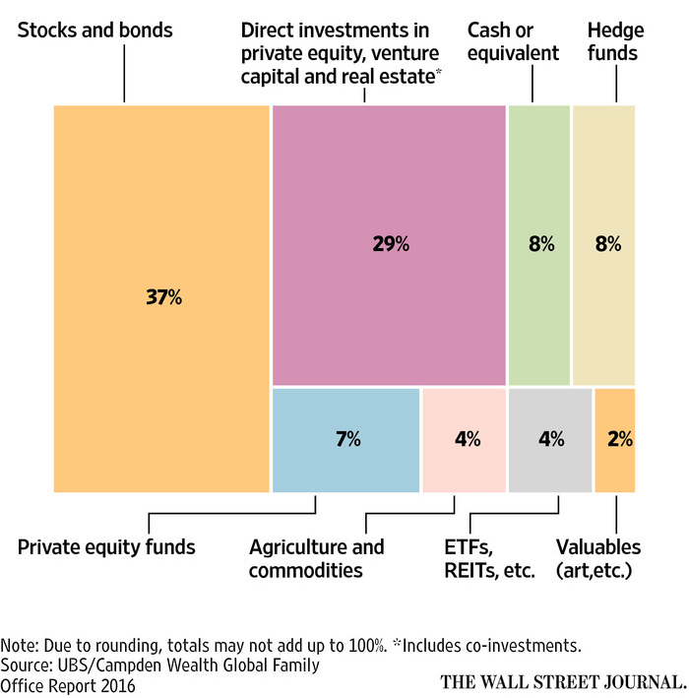
Model Family Office Portfolio:
Please see: Al W. King III and Pierce H. McDowell III, “Selecting Modern Trust Structures Based on a Family’s Assets” Trusts & Estates Magazine, August 2017.

Slide 18
Adding Investment Management LLC to the Flexible Modern Directed Trust:
Investment Management LLC – Flexible Modern Directed Trust
Manager (Investment Management LLC) – Grantor, Grantor’s Family or Family Advisor
Owner/member (Investment Management LLC) – trust/trustee (100%)
Flexible Modern Directed Trust Investment Committee
Directs that Investment Management LLC responsible for trust investments
.
Please see: Al W. King, III “Myths About Trusts and Investment Management: The Glass is Half Full!” Trusts & Estates Magazine, December 2014

Slide 19
Example: Flexible Modern Directed Trust With Investment Management LLC:
Investment Advisor or Committee
South Dakota Trust
Directs trustee to hold Investment Management LLC
Directs trustee regarding investments
South Dakota Trust Company LLC (SDTC) as directed administrative trustee
Distribution Advisor or Committee
Investment Management LLC
Directs trustee regarding distributions
Manager/family or family advisor
Sole member owner/SDTC
Please note: Combine Investment Advisor and Distribution Advisor → Trust Advisor

Slide 20
Flexible Modern Directed Trust with Investment Management LLC:
Key Uses of Investment Management LLC:
Grantor – self direct investments
Millennial beneficiaries – self direct investments (social impact)
Seeking funds and companies with environmental, governance and/or social goals
Real estate – residence and/or vacation home
Private Placement Life Insurance
Important Advantages:
Ease of administration
Added asset protection
Added state income tax advantages

Slide 21
Flexible Modern Directed Trust - Distributions:
Possible Distribution Committee Members:
Family
Family Advisors
Independent Directed Trustee(s)
Promote Family Values (Family Distribution Committee):
Promotes fiscal and social responsibility
Distributions from Non-Charitable Flexible Modern Directed Trust to Charity
Trust receives full charitable deduction – IRC Section 642 (c)
Please note: Al W. King III, “Charitable Giving With Non-Charitable Trusts” Trusts & Estates Magazine, June 2015

Slide 22
Charitable Deduction – Non-Charitable Trust:
IRS permits charitable deduction for distributions made from non-charitable trusts to charity:
Section 642(c): Provides that any part of the gross income of a trust, without limitation, that pursuant to the terms of the governing instrument, is paid during a taxable year for a charitable purpose/organization (specified in 170(c)) shall be allowed as a deduction to the trust without limitation
642(c) Keys:
During the tax year
From gross income (i.e. not from corpus or principal), including gross income accumulated in earlier years
Purpose specified in Section 170(c)
Pursuant to terms of the governing instrument (i.e. trust or will)
22

Slide 23
Flexible Modern
Directed Trust:
Directed Trust (Trifurcated Fiduciary Structure):
Investment Advisor or Committee
Administrative Trustee
Directs trustee regarding investments
Distribution Advisor or Committee
(Administrative trustee) as directed administrative trustee
Directs trustee regarding distributions
*Please note: Combine Investment Advisor and Distribution Advisor → Trust Advisor

Slide 24
Grantor Appoints a Trust Protector With Following Powers: (Vary by State Statute)
Power to remove or to replace trustees
Power to veto or direct trust distributions
Power to veto or direct investment decisions
Approve trustee accounts
Amend the trust as to the administrative, dispositive and tax provisions
Power to add or remove beneficiaries
Consent to exercise power of appointment
Power to change situs and the governing law of the trust
Terminate the trust
Advise the trustee on matters concerning a beneficiary
Provide direction regarding notification of qualified beneficiaries (Beneficiary quiet trusts)

Slide 25
Typical Flexible Modern Directed Trust with Trust Protector:
Trust Protector
(Family, Friends or Advisors)
Investment Advisor or Committee
South Dakota Trust
Directs trustee regarding investments
Trust Company as directed administrative trustee
Distribution Advisor or Committee
Directs trustee regarding distributions
Please note: Investment advisor/committee and distribution advisor/committee may be combined as a trust advisor.

Slide 26
Selected Popular Modern Directed Trust States with No State Income Tax:
Alaska
Delaware
Nevada
New Hampshire
South Dakota
Tennessee
Wyoming
Please note: Client does not have to live in these states to take advantage of their favorable trust and tax laws. All they need to do is to establish a trust in the states administered by a trustee in these states.
26

Slide 27
“Preserving Family Values by Encouraging Social & Fiscal Responsibility with Modern Trust Structures”
Grantor values
Beneficiary values
Family values
27

Slide 28
Designing the Incentive Family Dynasty Trust:
Incentive Trust Defined: Trusts with provisions designed to encourage or discourage certain types of behavior.
Promote social and fiscal responsibility via trusts:
Passing values and life lessons is considered the most important legacy by more than 75% of baby boomers and their parents (New York Times)
Trying to help beneficiary recognize some aspect of what got grantor to where they got so that some aspect of grantor’s heritage can be valued and perpetual (Calibre).
Leave kids enough so they do something, but not enough so they do nothing - Warren Buffet
Remember values and names of great-grandparents
Promoting social & fiscal responsibility within the family (family values)
Key Ages for Beneficiary Development: 20-40
Generally: post age 40 retain trust for tax savings, asset and divorce protection, etc.
28

Slide 29
Designing the Incentive Family Dynasty Trust (cont’d):
Motivation:
External Motivation: (act done for outward reward or fear of failure)
Internal Motivation: (act done for its own sake and because they enjoy it, i.e. enthusiasm and passion)
Motivation Summary:
Want motivation to come from inside not be supplied from outside;
Money and material goods are external and happiness is internal;
Training process for families;
Handing down values can be achieved in a more positive, less threatening manner through charitable endeavors (Calibre);
Best: If “Directed” regarding trust administration and discretionary regarding distributions
29

Slide 30
Sample Incentive Provisions for Directed Trusts:
Promotion of Fiscal Responsibility (External Motivation):
Draft family mission statement [and] videotape family goals (transcribe);
Incentive Clauses (i.e. $2 of trust income for each $1 of W-2 income) – exceptions, i.e. disability;
Distribution audit to determine suitability of future distributions – Cap distributions based upon beneficiaries’ net worth indexed for inflation;
Assumption $7.5M enough to live well, but have to protect it (Financial Counsel).
Supplemental income for socially responsible profession, i.e. artist, musician, teacher, etc;
Monthly Stipend for stay at home parent, also adult child to care for elderly relative;
Education costs for family in perpetuity;
Lump sum received at college graduation and/or advanced degree(s) (depending upon quality, academic rigor and college reputation);
If stipulate 3.0 GPA, may choose easier courses.
Monthly payments for Academic Excellence ;
Medical costs for family in perpetuity;
Denial of distributions if beneficiary fails a drug test or psychological treatment;
Family Bank: Loan to Beneficiary (term insurance purchased to provide repayment);
Denial of distributions if beneficiary does not participate in family meetings re charitable giving, family investments, estate planning and trusts.
30

Slide 31
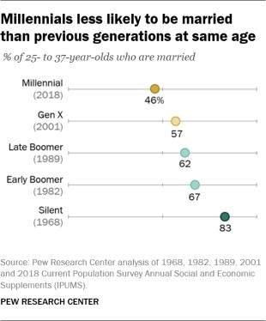
Millennials Are Starting Families Later in Life:
46% of Millennials are married
The share of adults who haven’t married is increasing with each generation
25% of today’s young adults won’t be married by ages 43 to 53
.
Source: Pew Research Center, “Millennial Life: How Young Adulthood Today Compares With Prior Generations” May 14th, 2020

Slide 32
Divorce:
Statistics:
40% – 50% of first marriages end in divorce
60% – 67% of second marriages end in divorce
Parents and beneficiaries worried regarding inheritances and divorce
Generally protected
Possible issues:
Co-mingling of assets
Certain state spendthrift clause statutes
Source: American Psychological Association
32

Slide 33
Inheritance & Divorce:
All 50 trust jurisdictions:
Offer asset protection
Through the incorporation of the spendthrift clause to a trust
Spendthrift Clause:
Prevents the attachment or assignment of a beneficiary’s interest in a trust
Prevents all but exception creditors from attaching the trust
Spendthrift Clause Exception Creditor:
Alimony
Possible issues in some states
Source: Al W. King III, “An Update on Third-Party Discretionary Trusts With Spendthrift Provisions” Trusts & Estates Magazine, October 2019

Slide 34
Inheritance & Divorce (cont’d):
Berlinger v. Casselberry, 38 Fla. L. Weekly D 2482 (Fla. Dist. Ct. App., Nov. 27, 2013)
Father set up third party trust for family (i.e., Son)
Florida Trust Code interpreted so former spouse of son could access trust assets to satisfy alimony:
Florida Spendthrift Clause exception creditor: Alimony
Court held - Florida state law allows court to order writ of garnishment against Florida discretionary trust
Solution: Flexible Modern Directed Trust states – Discretionary Interest statutes prevent garnishment
34

Slide 35
Discretionary Interest Statute (Flexible Modern Directed Trust):
Beneficiary does not have right to distribution
Beneficiary does not have property interest
No creditor may attach [or] force distribution from the trust
Reason no enforceable right
Discretionary Interest statute (Restatement 2nd) in many Flexible Modern Directed Trust states

Slide 36
Additional Incentive Provisions for Divorce Planning & Directed Trusts (cont’d):
Divorce:
Discretionary Interest Protection: to supplement Spendthrift Clause
Floating Spouse Clause (in-laws): define in-law spouses as “spouse I am married to and living with”;
Deny trust payments unless beneficiary has a prenuptial agreement;
Real Estate – “Use Factor”: buy real estate for children, grandchildren within the trust and they “use” it tax free (protects house from divorce);
Versus - upon marriage, check to purchase home or to place down payment on home (possible divorce problem)
Clause to encourage descendants to stay in marriage while children are minors – “vest” extra in trust
Beneficiary conflict clause – if beneficiary sues, they get nothing
36

Slide 37
Promotion of Social Responsibility:
Family goals vs. Philanthropic goals:
Family goals are not the same as philanthropic goals
Successful philanthropy can reinforce family values and strengthen a family legacy
Philanthropy integrated into lives of family as well as investments, business activity and lifestyle*
Source: Arabella – Philanthropic Investment Advisors
*Source: BNP Paribas Wealth Management
37

Slide 38
Charitable Giving:
72% of Baby Boomers donate to charities
43% of all charitable donations
84% of millennials gave to charities
59% of Generation X gave to charities
88% of Silent Generation gave to charities
26% of all charitable donations
Source: Charitable Giving Statistics for 2023 by Taylor Schulte
38

Slide 39
Inheritance (cont’d):
~33% of Baby Boomer parents believe that their children did not inherit their family’s commitment to charitable giving.
70% of Millennials believe their parents are not as committed to charitable giving as they are.
32% of Millennials and Generation Z (vs 14% of Baby Boomers) believe that they “give back” through impact investing.
Millennials and Generation Z are also 3x more likely to consider their professional contributions a method of “giving back”.
Source: Bank of America Newsroom, “Generations Collide as Millennials Redefine Work, Wealth Family and Influence Finds U.S. Trust 2017 Insights on Wealth and Worth Survey”
39

Slide 40
Sample Incentive Provisions for Directed Trusts (cont’d):
Promotion of Social Responsibility:
Prepare written document or transcribed videotape illustrating charitable desires, goals, values and purpose (i.e. mission statement);
As part of trust or as letter of wishes
Get buy in from family, advisors and distribution committee
Education – develop a family learning plan, family/distribution committee meetings, site visits to charities, advice from other philanthropists
Governance – distribution committee made up of family members (i.e., service members and junior members; possibly hire outside charitable advisor consultants)
Direct or indirect: Require trust make distributions to charity named in the trust [or] permit beneficiaries to select charities under guidelines outline in the trust (i.e., research and community involvement)
Participation: Require beneficiary to actively participate in charity if they want distributions made
Control over donations: If want beneficiaries to have control over distributions, the trust’s distribution committee directs that distributions be made to private foundations, donor advised funds, community foundations, supporting foundations, etc.
Charitable donations by family in perpetuity once dynasty trust attains a certain FMV:
The family distribution committee makes donations from the trust directly to charity, thus actively involving the family with charities and thus promoting the family values and mission statement
Trust investments – Social impact investing
Child works for charity, family foundation, or volunteers – Supplement Income
Encourage giving: Provide for trust to make matching distributions to beneficiaries equal to the percentage of charitable contributions they make each year.
Limited powers of appointment/separate shares (charitable giving option)
If beneficiary fails to meet trust performance standards, then funds divert to charity
Charity gift over
40

Slide 41
Summary of Popular Methods for Changing Existing Trust Situs to Another State:
Trust document:
Ability to change and/or add trustees
Change of situs and change of law clause
Trust Protector provisions
Reformation/Modification
Non-Judicial
Judicial
Decanting

Slide 42
Advantages of Non-Judicial Validation Statutes:
Trust validation provides a powerful tool for settlors who live anywhere who can create a trust in, or move a trust to non-judicial validation statute state (i.e., DE, SD) and follow the notice procedure to avoid validity challenges
Can be directed to only specific individuals (e.g. those who pose the threat of a contest)
Can target non-beneficiaries
Faster and cheaper
None of the disadvantages accompanying litigation which could deter the use of the procedure
Simply uses a statute of limitations instead of adjudication

Slide 43
Example: Non-Judicial Validation Statute:
A person may not commence a legal proceeding to contest the validity of a trust later than “Sixty days after the trustee, trust advisor, trust protector, or the settlor sent the person who is contesting the trust a copy of the trust instrument and a notice informing the person of the trust's existence, of the trustee’s name and address, and of the time allowed for commencing a proceeding”
Generally, 60 to 90 day statute of limitations period
Statute upheld in Matter of Elizabeth A. Briggs Revocable Living trust, although that case involved a post-death notice

Slide 44
Protecting Family Heirlooms [and] Pets – Purpose Trust:
Definition:
A trust with no beneficiaries
Trust that exists for stated (non-charitable) purpose
Established to care for “something” rather than “someone”
Trust Enforcer:
Appointed to ensure the trustees carrying out their obligations in fulfilling the trust’s purpose
Ability to go to court
Also Trust Protector: monitor and amend the trust if needed in event circumstances change
May reform/modify to beneficiary trust in the future
May combine Trust Enforcer and Trust Protector functions
Administrative trustee: purpose trust jurisdiction
Dynasty Trusts: Long term or perpetual
Taxes: Typically excluded from estate as completed gift trusts (either grantor or non-grantor)
Also pour over revocable purpose trust with dynasty provisions
Please see: Al W. King, III “Trusts without Beneficiaries – What is the Purpose?” Trusts & Estates magazine, Feb 2015

Slide 45
Protecting Family Heirlooms [and] Pets – Purpose Trust (cont’d):
Examples:
Pet care (i.e., dogs, cats, horses, birds, tortoises, snakes, etc.)
Including offspring
Charitable gift over when pet dies
Maintenance of grave sites (honorary)
Also supporting religious ceremonies (anniversaries, etc.) – Charitable donations
Maintenance of family property (i.e., antiques, cars, jewelry, memorabilia, etc.)
Maintenance of an art collection
Maintain family homes (residence and vacation)
Long term maintenance of building, property or land
Maintain business interests
Royalties
Digital assets
Provide for philanthropic purpose not qualifying for a charitable deduction
Assets in purpose trust are generally sold after purpose ended
Convert to beneficiary trust [and/or]
Charitable gift over

Slide 46
Powerful Modern Trust Administration Structures for the Ultra Wealthy Promoting Family
Social and Fiscal Responsibility:
Directed Trust
Distribution and investment committees
Promoting family values
Special Purpose Entity Combined with a Directed Trust
See Appendix A
Trust Protector Company Combined with a Directed Trust
See Appendix B
Private Family Trust Company – See Appendix C
Regulated
Unregulated
46

Slide 47
“Preserving Family Values by Encouraging Social & Fiscal Responsibility with Modern Trust Structures”
QUESTIONS?

Slide 48
Appendix A
Example: Modern Directed Trust Combined
With a Special Purpose Entity [or] Trust Protector Company:
Special Purpose Entity (SD LLC)
Board of Managers
Investment Advisor or Committee
South Dakota Trust
Directs
Distribution Advisor or Committee
Trust company as directed trustee
Trust Protector

Slide 49
Appendix A Advantages of Special Purpose Entity(SPE):
SPE is an LLC – wrapper for Investment Committee, Distribution Committee and Trust Protector of a Modern Directed Trust
Inexpensive – Average cost to establish: $3,500
Not a trustee (cannot be held out as trust company for public)
Required to work with a Qualified Trustee
Advantages of SPE:
D&O/E&O Insurance – [versus] personal liability as fiduciaries without insurance
Governance – Family meetings etc..
Substantial presence – trust situs

Slide 50
Appendix B
Trust Protector Company (TPC) or
Qualified Trust Advisor (QTA) (Alternatives to SPE):
Popular States: Delaware (TPC), Wyoming (TPC) and New Hampshire (QTA)
Purpose: House the trust protector as well as investment and distribution committees (TPC) or trust advisor and trust protector (QTA)
Required Trustee: Generally any directed trust jurisdiction with a trust protector
statute
Required Trust Law: Generally any directed trust jurisdiction with a trust protector statute
Summary: Delaware, New Hampshire and Wyoming TPC/QTA can serve with trustee of a directed trust in another trust jurisdiction
50

Slide 51
Appendix C Private Family Trust Companies (PFTC) - Introduction:
A growing and popular trend among ultra wealthy families is the creation of their own Private Family Trust Company (PFTC) to serve as trustee for their trusts:
Two types of PFTCs:
Regulated: (Typically family net worth's $100 million and above)
Unregulated: (Typically family net worth's $25 million and above)
Popular PTC states: Nevada, New Hampshire, South Dakota, Tennessee, Texas and Wyoming
51

Slide 52
Appendix C
What is a Private Family
Trust Company (PFTC)?
The unregulated PFTC and the regulated PFTC
A Private Family Trust Company (PFTC) is a family-owned entity (e.g. LLC) authorized by state or federal law to operate as a trust company serving their family as trustee for family trusts
Structured like a corporation – Typically an LLC:
Shareholders/Unit holders
Board of Directors/Board of Managers (LLC)
Investment Committee
Distribution Committee
PFTC Owner – Family, trust, or purpose trust
Family Members and
Trusted Independent Advisors
*Source: Al W. King III, “Tips From the Pros: The Private Family Trust Company and Powerful Alternatives” Trusts & Estates Magazine, February 2016.
52

Slide 53
Appendix C PFTC Advantages:
Enables family fiduciaries to effectively and efficiently work with family office and outside product and service providers
SEC exemption - regulated (only available with regulated)
Corporate Transparency Act Exemption - (only available with regulated)
Enhanced family governance -
Framework for family to participate in administration of family wealth
No incapacity, death or retirement issues with trustee (LLC perpetual)
Employment opportunities for family
Promote social and fiscal responsibility - family values
Families experiencing issues with banks & institutional trustees:
PFTC services tailored to meet family’s needs
Family control over transition of both advisors and employees
Efficient - controls overhead and provides economies of scale
Better informed trust distribution and investment decisions
53

Slide 54
Appendix C PFTC Advantages (cont’d):
Investment flexibility -
Ability to hold one private or public asset without diversification
Allow for sophisticated asset diversification
Illiquid assets
Possibly deduct investment management fees for trusts
Privacy
Avoids personal liability - D+O/E+O Insurance for PFTC fiduciaries
Gross negligence and/or willful misconduct liability standard
Better to recruit independent directors as well as investment, distribution and amendment committee members
Closely held stock
Real estate
Oil & gas
Gambling assets (i.e. hotels with casinos)
Environmental assets
54

Slide 55
Appendix C Regulated vs. Unregulated:
 | Regulated | Unregulated
Net Worth | $100 mm above | $10 million - $25 million above
Entity | LLC | LLC
Time Frame to Set-up | 6-8 months (charter) | 3-4 weeks (license – authorized & recognized)
PFTC State Division of Banking Audits | Yes – every 3 years in most states | No
SEC Exemption | Yes | No
Capital Requirements | $200k - $500k | None – highly suggested (e.g., $10k)
D&O & E&O Insurance | Yes | Yes
Board Meetings | Most states require 2 - 4 per year | None required – highly suggested at least one annually
55

Slide 56
Appendix C Regulated vs. Unregulated (cont’d):
 | Regulated | Unregulated
Board Member and/or Officer – PFTC State | - Yes, most require one resident board member - Some require resident officer - Some neither | No, but highly suggested
Safe Deposit Box/ File/Safe | Yes | No, but highly suggested
PFTC State Physical Office | Minimal – office space, service provider and registered agent | Registered agent address only – no office required
Policy and Procedure Manual | Yes | No, but highly suggested
56

Slide 57
Al W. King III Co-Founder, Co-Chairman and Co-Chief Executive Officer, South Dakota Trust Company, LLC and SDTC Related Companies
Al W. King III is the Co-Founder, Co-Chairman and Co-Chief Executive Officer of South Dakota Trust Company LLC (SDTC) and SDTC Related Companies with offices in South Dakota, New York, Wyoming, Nevada and Westport, CT. SDTC is a national trust boutique serving wealthy families from 54 countries and 47 states. SDTC currently has more than $140 billion in assets under administration.
Mr. King was previously Managing Director and National Director of Estate Planning for Citigroup. Mr. King was also the Co-Founder and Vice Chairman of Citicorp Trust South Dakota. Mr. King also previously served as Director of Financial and Estate Planning for Coopers and Lybrand in Stamford, Connecticut.
Mr. King is the Co-Vice Chairman of the Editorial Board of Trusts & Estates Magazine. He has been a member of the Editorial Board for over 30 years. Mr. King has been inducted into the National Association of Estate Planners & Councils (NAEPC) Estate Planning Hall of Fame as an Accredited Estate Planner (AEP), Distinguished. Mr. King previously served on the Board of Directors for NAEPC and is the Former Chairman of the NAEPC Foundation Advisory Board. He is currently a member of both the NAEPC webinar and publications committees. He is also a member of several groups and organizations including the Society of Trust and Estate Professionals (STEP), the International Association of Advisors in Philanthropy (AiP), New York Philanthropic Advisors Network (NYPAN), Fairfield County and New York City Estate Planning Councils, etc. In addition, he is frequently published and quoted by several publications on various Estate Planning topics and addresses several professional organizations, special interest groups, and general audiences on the subject of estate and trust planning.
Mr. King received a Bachelor of Arts cum laude from Holy Cross College, a Juris Doctor from Syracuse University College of Law and an LL.M. in Tax Law from Boston University School of Law.

Slide 58
Co-Chairmen and Co-Chief Executive Officers Selected List of Speaking Engagements:
NY State Banker’s Association (Marketing and Estate Planning Seminars) | Cleveland Clinic Donors | InfoVisa Technology Conference – Key Note Speaker – Sept 2007 (TX)
National AICPA Personal Financial Planning Conference | Sacred Heart University Alumni | Hawaii Tax Institute – Oct 2007
National Conference of CPA Practitioners | Merrimac College Alumni | Notre Dame Tax Institute 2007
NY State Society of CPAs Personal Financial Planning Conference (95-96) | Hofstra University Alumni | Heckerling Insurance - January 2008
NAPFA - Advanced Planners Conference (Williamsburg, VA) | Syracuse University Alumni | AICPA Tax Strategies for the High-Income Individual (Las Vegas, NV) – May 2008
Institute of Certified Financial Planners (NYC) | Holy Cross College Donors | AALU Annual Meeting (D.C.) – May 2008
International Association of Financial Planners | Bridgeport Hospital Medical Staff | Financial Events International – Advanced Trust Planning (NYC) – 2008
National Fortress Conference (Dallas) | Various Rotary and Jaycees Events | Family Office Seminar (Aventura, FL) – May 2008
American Association of Retired Persons | Several Fortune 500 Companies | STEP (San Francisco) - September 2008
American Association of Independent Investors | Florida Bar (Business Section) | NAEPC Webinar - September 2008
Connecticut Estate and Gift Tax Council | New York CPA Network (NYC) | Hawaii Tax Institute - October 2008
Connecticut Society of CLUs | Florida CPAs | Heckerling Luncheon – January 2009 (Orlando)
CPAs in Industry Society (Ohio) | Denver CPAs | Lorman - February 2009
Financial Executives Institute (NJ) | San Francisco CPAs - October 1996 | Rockland County Estate Planning Council – February 2009
Long Island Federation of Women’s Clubs | Chicago CPAs - November 1996 | WTAS Webinar – February 2009
California CPAs | New York Society of CPAs PFP Seminar - June 1997 | NAEPC Webinar – March 2009
Colorado CPAs | New York City Bar - June 1997 | Wealth Counsel Annual Meeting (Chicago, IL) – August 2009
Los Angeles CPAs - October 1996 | Washington County Hospital Association | Institute for Private Investors (New York, NY) – December 2009
New Jersey State CPA Society Seminar 1996, 1997 | National AICPA PFP Technical Conference - 1999 | Family Office Exchange Webinar – January 2010
Million Dollar Round Table Conference - June 1997 | Institute for Private Investors (NYC 2001) | Heckerling Luncheon – January 2010 (Orlando)
Hawaii Tax Institute - October 1997 | Long Island Bar Association (2001) | Ventura County EPC - May 2010
American Bar Association - August 1997, 1998 | Naples, Florida Estate Planning Council-March 2002 | American Bar Association (ABA) Webinar - June 2010
Nevada Estate Planning Council | Fairfield County Connecticut Estate Planning Council - Oct 15, 2002 | Interactive Legal Webinar- September 2010
Estate Planning Councils: Hartford, Westchester, Rockland, Miami | AIG Adv. Pl. Seminars LI, NYC, NJ, Westchester County Feb/Mar 03 | Hawaii Tax Institute- October 2010
Maryland Bar Association | NY CPA's Closely-Held Group - June, 2003 | South California Tax Institute- October 2010
Bank Administration Institute (BAI)-March 2002 | UNCW Institute for Tax and Investment Planning – November 2003 | NAEPC Annual Conference- November 2010
President Bush Inaugural Dinner Sponsored by Salomon Smith Barney | Southern California (Orange County) Estate Planning Council – March, 2004 | Heckerling Luncheon- January 2011 (Orlando)
The Planned Giving Council of Central Florida - September 19, 2002 | South Dakota Estate Planning Council – November, 2004 | Family Office Exchange (FOX)- February 2011
NY State CPA's Estate Administration Conference NYC - May, 2003 | Producers Group – February 2005 | NYCPA Family Office Group- February 2011
NYC Trusts & Estates Magazine Conference - October 20, 2003 | AXA Advisors (PPG) – March 2005 | Estate Planning Council of San Gabriel Valley- March 2011
Nevada Estate Planning Council – January, 27 2004 | Los Angeles STEP Chapter – May 2006 | Todorovitch Lecture- March 2011
Long Island Estate Planning Council – September, 2004 | Lorman (Buffalo and NYC) 2006 | Estate Planning Council of New York City’s Estate Planner’s Day- May 2011
International Forum – January, 2005 | Million Dollar Round Table – June 2006 (San Diego) | Hawaii Tax Institute on Estate Planning – December 2011
Red River Estate Planning Council (ND) – February, 2005 | Naples Estate Planning Council – September 2007 | Heckerling Luncheon- January 2012 (Orlando)
NYU Tax Institute – July, 2005 | Lorman Teleconference –November 2006 | Southern Arizona Estate Planning Council – March 2012
Citco Seminar – October 2005 | Heckerling Luncheon – January 2007 (Orlando) | Sioux Falls Estate Planning Council – April 2012
San Francisco CPA/Bar Alliance | AXA Equitable Agents –Feb 2007 (Boca Raton) | Family Office Exchange Webinar – May 2012
Tri-State LINC CPA Society | Lorman – February 2007 (NYC) | West River Estate Planning Council – June 2012
New York State Bar Association | NYCLE – May 2007 | CalCPA Peninsula/Silicon Valley Annual Estate Planning Symposium – July
Florida Bar Association | American Bar Association (ABA) Webinar – August 2007 | Hawaii Tax Institute – November 2012

Slide 59
Co-Chairmen and Co-Chief Executive Officers Selected List of Speaking Engagements (cont’d):
Fargo Estate Planning Council – November 2012 | Sioux Falls Estate Planning Council - May 2016 | Morgan Stanley Presentation (Northwest Region) – May 2021
Bergen County Estate Planning Council – November 2012 | PAC Seminar for Professionals – June 2016 | Morgan Stanley Presentation (Northwest Region) – May 2021
Heckerling Luncheon – January 2013 | Tiger 21 – June 2016 | Trusts & Estates Magazine Webinar – June 2021
Southern Nevada Estate Planning Council – March 2013 | IPI Roundtable – June 2016 | Morgan Stanley Presentation (Southwest Region) – May 2021
Central New York Estate Planning Council – May 2013 | Fusion Collaboration – July 2016 | UBS Advanced Planning Group Webinar – June 2021
2013 Business and Economic Forum – May 2013 | MSSB Presentation – September 2016 | UBS Kreiner Group Webinar – June 2021
Minnesota CLE’s Probate and Trust Law Conference – June 2013 | Advisors in Philanthropy – September 2016 | STEP Webinar – September 2021
Lorman’s New Era of Estate Planning in New York – July 2013 | FPPC – SALI Fund Services – September 2016 | South Dakota Trust Association Fall Forum – October 2021
Hawaii Tax Institute – October 2013 | 42nd Annual Notre Dame Tac & Estate Planning Conference – October 2016 | Family Office Exchange Webinar – November 2021
Inland Empire Estate Planning Seminar – November 2013 | Hawaii Tax Institute – November 2016 | Sioux Falls Estate Planning Council – March 2022
Heckerling Luncheon – January 2014 | Heckerling Institute on Estate Planning – January 2017 | Hawaii Estate Planning Council – March 2022
STEP 4th Annual Institute on Tax, Estate Planning & the Economy – January 2014 | Boston Estate Planning Council – April 2017 | Heckerling Institute on Estate Planning – March 2022
New York IPI Roundtable – April 2014 | Western Dakota Estate Planning Council (North Dakota) – May 2017 | New York Estate Planning Council – April 2022
Ave Maria School of Law – April 2014 | Hofstra Private Wealth & Taxation Institute – May 2017 | Ameriprise Financial – April 2022
Northern Florida (Jacksonville) Estate Planning Council - May 2014 | CalCPA Estate and Trust Planning Conference – July 2017 | Northcentral Pennsylvania Estate Planning Council – October 2022
San Francisco IPI Roundtable – September 2014 | Allied Professionals Summit – September 2017 | Suncoast Estate Planning Council – November 2022
Society of FSP Webinar – September 2014 | SALI Fund Conference – October 2017 | Morgan Stanley Presentation (Pac South) – November 2022
Trusts & Estates Magazine Webinar - October 2014 | Lehigh Valley Estate Planning Conference – October 2017 | Morgan Stanley Presentation (New England) – November 2022
Hawaii Tax Institute – November 2014 | Heckerling Institute on Estate Planning – January 2018 | Morgan Stanley Presentation (Central) – November 2022
Heckerling Luncheon – January 2015 | NYSSCPA International Taxation Conference – January 2018 | Morgan Stanley Presentation (Great Lakes) – November 2022
STEP 5th Annual Institute on Tax, Estate Planning & the Economy – January 2015 | Mercer County Estate Planning Council – February 2018 | Morgan Stanley Presentation (NY Metro) – December 2022
New York IPI Roundtable – March 2015 | STEP Naples – February 2018 | Morgan Stanley Presentation (Southeast) – December 2022
Advisors In Philanthropy Conference – April 2015 | Hawaii Tax Institute – November 2018 | Heckerling Institute on Estate Planning – January 2023
American Bar Associations Webinar – June 2015 | Heckerling Institute on Estate Planning – January 2019 | NAEPC Webinar – March 2023
Million Dollar Roundtable – June 2015 | Sacred Heart University High Net Worth Conference – June 2019 | Marcum NYC Presentation – March 2023
Penn Mutual Symposium – June 2015 | FPA of Orange County – October 2019 | Bucks County/ Montgomery County – April 2023
Northwestern Mutual Symposium – June 2015 | Hawaii Tax Institute – November 2019 | Notre Dame Tac & Estate Planning Conference – October 2023
Guardian’s BRC Symposium – August 2015 | Heckerling Institute on Estate Planning – January 2020 | Hawaii Tax Institute – November 2023
Notre Dame Tax & Estate Planning Institute – September 2015 | Family Office Association – May 2020 | Heckerling Institute on Estate Planning – January 2024
North County San Diego Estate Planning Council – October 2015 | Trusts & Estates Magazine Webinar – June 2020
Westchester Estate Planning Council – December 2015 | Trusts & Estates Magazine Webinar – September 2020
Heckerling Institute on Estate Planning – January 2016 | Family Office Exchange Webinar – November 2020
Lenox Advisors, Inc. Presentation – February 2016 | Trusts & Estate Magazine Webinar – January 20021
Berks County Estate Planning Council – March 2016 | Trusts & Estates Magazine Webinar – April 2021
South Dakota Law Review Symposium – April 2016 | Heckerling Institute on Estate Planning – May 2021
Desert Estate Planning Council – April 2016 | Morgan Stanley Presentation (Mid-Atlantic Region) – April 2021
Palm Springs Luncheon – April 2016 | Morgan Stanley Presentation (Midwest Region) – April 2021
Trusts & Estates Magazine Webinar – April 2016 | Morgan Stanley Presentation (Southeast Region) – May 2021
Tiger 21 Meeting – May 2016 | Morgan Stanley Presentation (New England Region) – May 2021
Boston Estate Planning Council – May 2016 | Morgan Stanley Presentation (Central Region) – May 2021

Slide 60
Co-Chairmen and Co-Chief Executive Officers Selected List of Publications:
Recent Selected Publications:
“Population Trends and Trust Planning” November 2023 Trusts & Estates magazine
“Importance of State Taxes in Estate Planning” September 2023 Trusts & Estates magazine
“The Safety of Trust Assets Versus Bank Assets” June 2023 Trusts & Estates magazine
“Supercharged Directed Trusts” April 2023 Trusts & Estates magazine
“Are Dynasty Trusts Only for The Ultra Wealthy?” November 2022 Trusts & Estates magazine
“Frequently Overlooked Trust Planning Considerations” June 2022 Trusts & Estates magazine
“Does a Perpetual Trust Need a Perpetual Private Foundation?” April 2022 Trusts & Estates magazine
“Flexible Trusts to Deal With Future Uncertainties” January 2022 Trusts & Estates magazine
“Unique Trends and Approaches to Charitable Giving” November 2021 Trusts & Estates magazine
“Zero Tax Trusts?” September 2021 Trusts & Estates magazine
"Important Trust Trends” June 2021 Trusts & Estates magazine
“Interesting Trends With Millennials and Trusts” February 2021 Trusts & Estates magazine
“Is a Wealth Tax in Our Future?” December 2020 Trusts & Estates magazine
“The Uniform Voidable Transactions Act – Continue to Be Aware” October 2020 Trusts & Estates magazine
“How Long-Term Trusts Can Assist With Uncertainties Like Covid-19” August 2020 Trusts & Estates magazine
“Safety of Client Trust Assets” June 2020 Trusts & Estates magazine
“Marinating Control in an Uncertain Environment” June 2020 Trusts & Estates magazine
“Can a Grantor Have His Cake and Eat It Too?” November 2019 Trusts & Estates magazine
“An Update on Third-Party Discretionary Interest Planning with Spendthrift” October 2019 Trusts & Estates magazine
“Privacy vs. Secrecy” August 2019 Trusts & Estates magazine
“Trust Designs in Light of Kaestner And Other Trends” May 2019 Trusts & Estates magazine
“Interesting Trends with Modern Trusts: Income vs. Estate Taxes” December 2018 Trusts & Estates magazine
“Decanting is a Popular Strategy, But Don’t Ignore Several Key Consideration” August 2018 Trusts & Estates magazine
“Trends and Opportunities for NRAs With U.S. Beneficiaries” June 2018 Trusts & Estates magazine
“Does Estate Tax Repeal Really Matter?” December 2017 Trusts & Estates magazine
“Are Incentive Trusts Gaining Popularity?” October 2017 Trusts & Estates magazine
“A Trust for Every Asset” August 2017 Trusts & Estates magazine
“The Trust Spendthrift Provision – Does it Really Protect?” December 2016 Trusts & Estates magazine
“Be Aware of the Uniform Voidable Transactions Act” October 2016 Trusts & Estates magazine
“The Private Family Trust Company and Powerful Alternatives” February 2016 Trusts & Estates magazine
“Drafting Modern Trusts” December 2015 Trusts & Estates magazine
“Domestic Trust Situs Opportunities for International Families” October 2015 Trusts & Estates magazine
“Trust Options for Residential Real Estate” August 2015 Trusts & Estates magazine
60

Slide 61
Co-Chairmen and Co-Chief Executive Officers Selected List of Publications (cont’d):
“Charitable Giving with Non-Charitable Trusts” June 2015 Trusts & Estates magazine
“Should you keep a trust quiet (silent) from beneficiaries?” April 2015 Trusts & Estates magazine
“Trusts without Beneficiaries – What is the Purpose?” February 2015 Trusts & Estates magazine
“Myths About Trusts & Investment Management: The Glass is Half Full!” December 2014 Trusts & Estates magazine
“Defend Against Attacks on DAPTs” October 2014 Trusts & Estates magazine
“What’s Trending in the Estate Planning World” August 2014 Trusts & Estates magazine
“Trust Planning in 2012 and Beyond” May 2012 Trusts & Estates magazine
“State Premium Tax Planning” June 2011 Trusts & Estates magazine
“Private Trust Company 101” April 2011, Family Office Exchange (FOX) FOXConnects
Family Office Exchange (FOX): Fall Forum Resource Center White Paper – “The Modern Dynasty Trust: Flexibility and Control”
Family Office Exchange (FOX): Fall Forum Resource Center White Paper – “Trust Administration of the Ultra Wealth: The Private Trust Company and Other Key Alternatives”
Family Office Exchange (FOX): Fall Forum Resource Center White Paper – “Modernizing an Existing Irrevocable Trust: Reformation, Modification and Decanting”
Family Office Exchange (FOX): Fall Forum Resource Center White Paper – “Large Domestic Insurance Premiums: Do Not Forget to Plan for the State Premium Tax”
Family Office Exchange (FOX): Fall Forum Resource Center White Paper – “Directed Trusts, Trust Protectors & Special Purpose Entities”
“Delegated Vs. Directed Trusts” July 2006 Trusts & Estates Magazine
“The PPLI Solution (Chapter 6: “Trust Administration: The Domestic Advantage”)” February 2005 Bloomberg Press
“Estate Planning and the State Premium Tax” February 2005 AUS
“What Does the 2001 Tax Relief Act and Estate Tax Phase-Out Mean for the States? It Is Not a Rosy Picture – the Impact Is Already Dramatic!” March 2004 Nebraska Lawyer
Footnoted: "Dynasty Trusts and the Rule Against Perpetuities" 116 Harvard Law Review 2588 (2003)
“Freezers - our Future Coffins” August 2002 Trusts & Estates Magazine
“How To Play the Current Downturn – And Plan for a Decade of Evolving Estate Tax Rules” January 2002 Trusts & Estates Magazine
“Non-Disclosure Agreements – Help or Hindrance to a Client’s Planning” August 2001 Trusts & Estates Magazine
“Multi-Disciplinary Practices Important due to Economic, Tax Uncertainty” August 2001 Trusts & Estates Magazine
“Death Tax Uncertainty Makes Flexible and Family Value Estate Planning More Important Than Ever” January 2001 trusts & Estates Magazine
“Smart Start - Establishing A Dynasty Trust in South Dakota” November 2000 Departures Magazine
“South Dakota Dynasty Trust” June 2000 Millionaire
“Population Trends, New Wealth Creation and HR 10 are Keys to the Future” January 2000 Trusts & Estates Magazine
“Changing the Situs of a Trust: Shopping for Income Tax Savings” September 1999 Trusts & Estates Magazine
“A Generation Skipping Trust: Unlimited Duration? Why Not? June 1999 Trusts & Estates Magazine
“Delegating Responsibility: Trustees Explore The Once Taboo” March 1999 Trusts & Estates Magazine
61

Slide 62
Co-Chairmen and Co-Chief Executive Officers Selected List of Publications (cont’d):
“Modern Trusts Are Being Created With More Flexibility Resulting in Assets Remaining in Trusts for Longer Periods of Time” January 1999 Trusts & Estate Magazine
“Sale to a “Defective” Trust Application as a Life Insurance Technique” April 1998 Trusts & Estate Magazine
“The Modern Dynasty Trust: Flexibility is more important than ever” January 1998 Trusts & Estates Magazine
“Trust Forum Shopping: The Next Generation” August 1997 Trusts & Estates Magazine
“Who benefits from the Suspension of Sec 4980A’s Excise Tax?” April 1997 Trusts & Estates Magazine
“Dynasty Trust” September 1996 The CPA Journal
“Trust Planning: Experts Critical Analysis of the Dynasty Trust, A Unique Planning Device to Preserve and Create Wealth” June 1996 Insights and Strategies CCH
“Dynasty Trust Planning and Your Artwork” May 1996 Christie’s Auction News
“Dynasty Trusts: What the Future Holds for Today’s Technique” April 1996 Trusts & Estates Magazine
“When to Consider a Corporate Trustee” Part II December/January 1996, AICPA Planner
“When to Consider a Corporate Trustee” Part I November 1995 AICPA Planner
62

Slide 63
Co-Chairmen and Co-Chief Executive Officers Selected List of Publications (cont’d):
Tapes and Published Outlines Available:
1997 Million Dollar Roundtable - Atlanta, Georgia (Dynasty Trusts)
1998 American Bar Association Advanced Drafting Meeting - Dallas, Texas (Dynasty Trusts)
1998 Texas Bar Association Advanced Drafting Meeting - Dallas, Texas (Dynasty Trusts)
1999 National AICPA Technical PFS Conference - Las Vegas, Nevada (Dynasty Trusts)
2000 Sky – TV Net Worth (Dynasty Trusts)
2000 Salomon Smith Barney National Sales and Marketing Focus (Dynasty Trusts)
2004 Society of Financial Services Professionals (SFSP) – "Park Avenue Meets Main Street: Family Office Techniques for the Millionaire Next Door" DVD
2005 International Forum – “Advanced Planning with a Modern Corporate Trustee”
2006 Society of Financial Services Professionals (SFSP) – “Advanced & Creative Estate Planning (with a Modern Corporate Trustee) in an Uncertain Tax and Economic Environment”
2006 Million Dollar Round Table – “Creative Uses of Life Insurance in Trust Planning” San Diego
2007 AALU National Webinar – “Creative Uses of Life Insurance in Trust Planning”
2008 AICPA Tax Strategies for the High-Income Individual- May 9, 2008 – “Selection of Domestic Trust Jurisdictions: Does It Make A Difference?"
2009 Family Office Metrics Webinar – “The 21st Century Private Family Trust Company”
2009 Institute for Private Investors (IPI) – “2010: Uncertainty Means Opportunity for Modern Trust Planning”
2010 Family Office Exchange (FOX) Webinar – “The 21st Century Family Bank Dynasty Trust: What, Why, When, Where, How, Who?”
2015 Million Dollar Round Table – “Unique & Creative Uses of Modern Trusts Involving Investments and Insurance”
2016 42nd Annual Notre Dame Tax and Estate Planning Institute – “Creating Modern Trust Structures: The Different Ways They Should Be Used”
63

